Slide 1

Network Intrusion Detection System with Machine Learning Approach
Edwin Valdez
Data 606

Slide 2

What is Network Intrusion Detection System
This is a security system that monitors the network activity to detect malicious activity that might be harmful to any company.
It is common to implement Network Intrusion Detection System (NIDS) in big companies as another layer of security against bad actor attack.
The benefits of having a NIDS are numerous since, in many cases, the system alerts the security team about the possible malicious attack and uses that information to plan a risk management plan.

Slide 3
Objective of this project
The main objective of this project is to transform a traditional NIDS into a new system with the help of machine learning, in particular neural network algorithm.
The use of a Neural network is ideal for this project because network traffic generates large datasets. It needs an algorithm that would handle large amounts of data and properly predict the type of network attack.
Neural network would provide analysis on the network traffics, and it would determine what kind of attack the network is suffering.
Therefore, at the end of this project, we will use build a model that would predict malicious traffic in a typical business network.

Slide 4

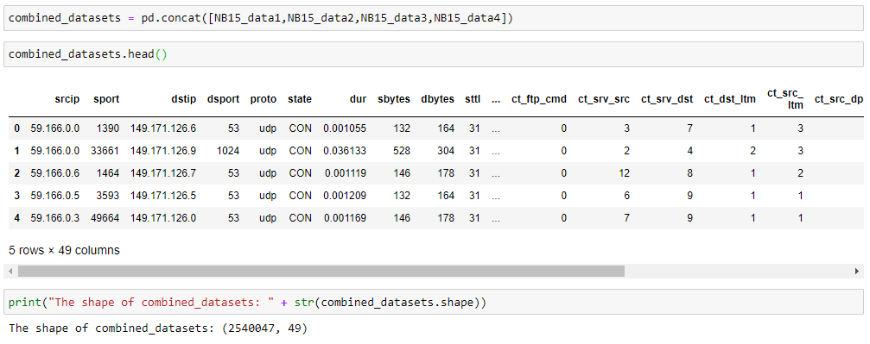
Dataset to use for this project
For this project, we are going to use UNSW-NB15 Dataset.
This dataset contains raw network packets created by the IXIA PerfectStorm tool in the Cyber Range Lab of the Australian Centre for Cyber Security (ACCS).
The total of records on this dataset is around two million, with a total of 49 features.
Notes:
University of New South Wales

Slide 5
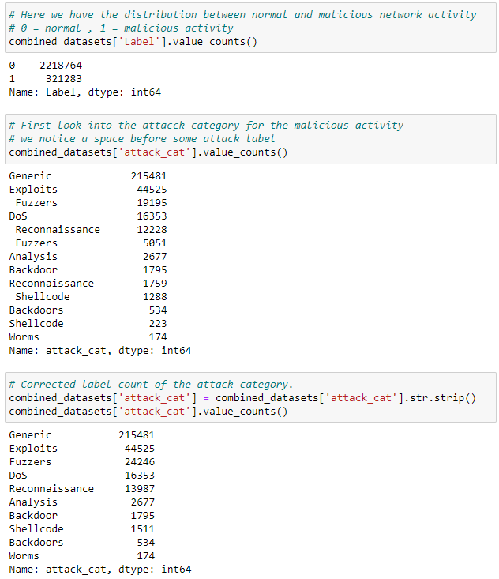
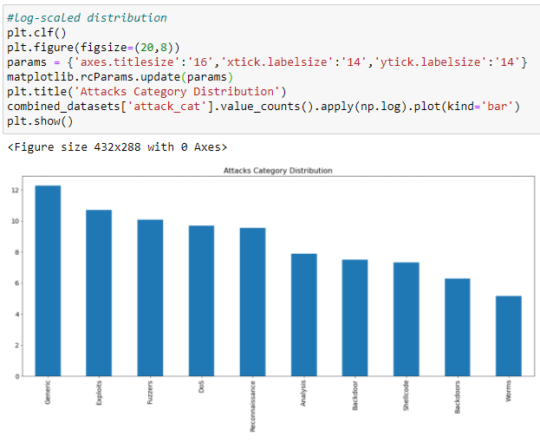
Data Analysis
The dataset contains a good balance between malicious activity and normal activity.
There are nine different types of malicious activity between Fuzzers, Analysis, Backdoors, DoS, Exploits, Generic, Reconnaissance, Shellcode, and Worms

Slide 6
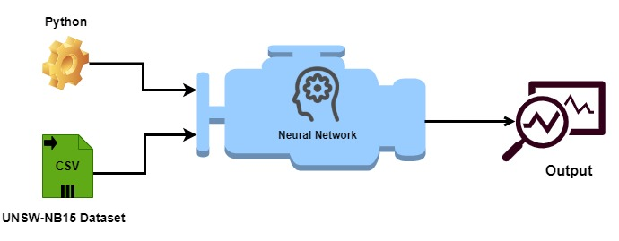
Design architecture
In this architecture, we are looking to input our dataset and processing all that data in python for cleaning y transformation. After that, we are applying the transformed data to our neural network algorithm to get our output.

Slide 7

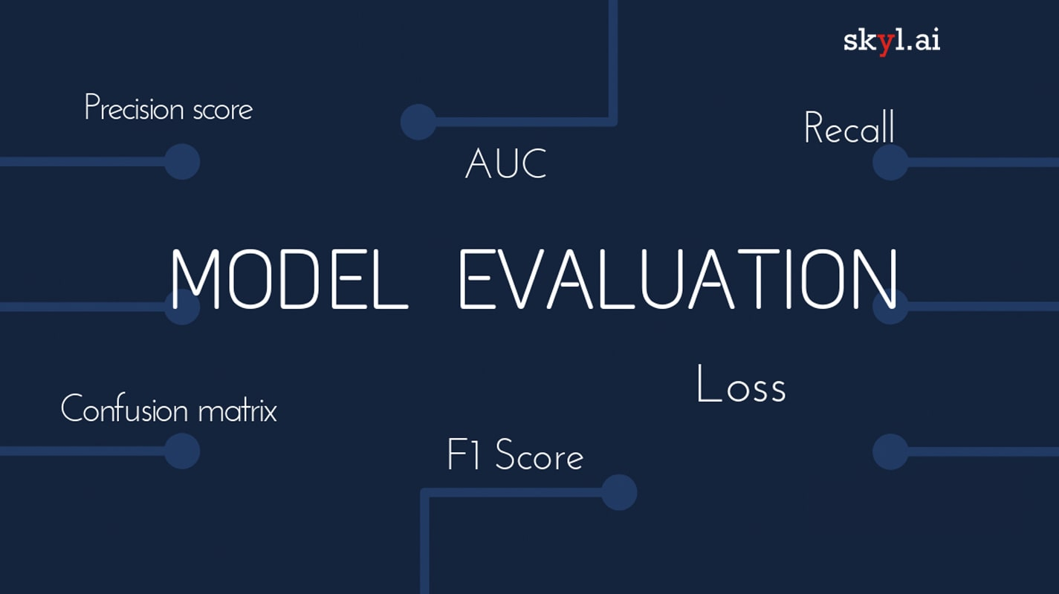
When will we consider this project successful or not ?
The objective of this project is to build an algorithm that can reach above 85 % accuracy and recall.
In addition, the use of metrics like F1-score to evaluate our model.
The aim of this model is to detect malicious network activity based on the label classification that is provided in our datasets.

Slide 8

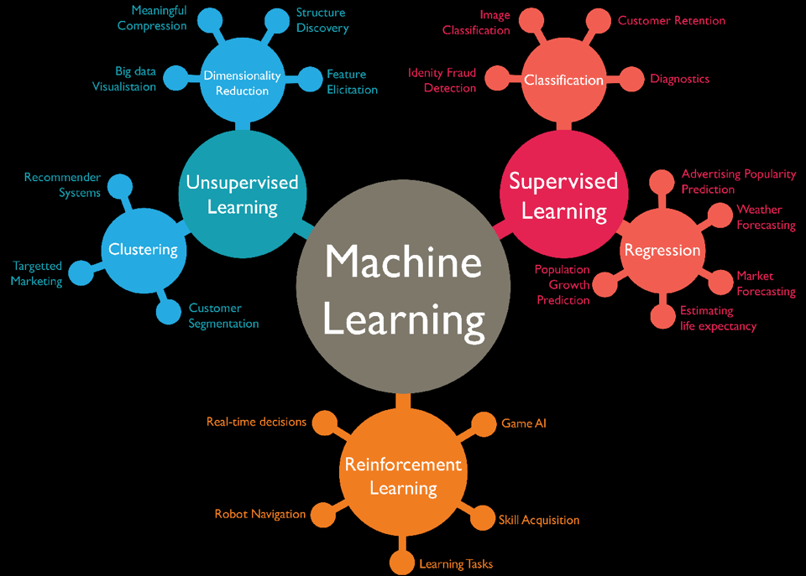
Similar Research Work
Some of the similar work related with intrusion detection are:
Evaluation of Machine Learning Algorithms for Intrusion Detection System (IDS). Author Cuelogic Technologies.
Evaluation of Machine Learning Algorithms for Intrusion Detection System. Authors: Mohammad Almseidin, Maen Alzubi, Szilveszter Kovacs and Mouhammd Alkasassbeh.
Network intrusion detection system: A systematic study of machine learning and deep learning approaches. Authors: Zeeshan Ahmad, Adnan Shahid Khan, Cheah Wai Shiang, Johari Abdullah, and Farhan Ahmad.
Notes:
There are different research that is similar to this topic.
Evaluation of Machine Learning Algorithms for Intrusion Detection System (IDS). Author Cuelogic Technologies.
Description: This is article explains the comparison between traditional IDS and IDS with machine learning by digging more into some of the options and logic behind an optimal IDS system with a machine learning algorithm added. This article differs from my project because my project would focus on a supervised machine with a classification model.
Link Source: https://medium.com/cuelogic-technologies/evaluation-of-machine-learning-algorithms-for-intrusion-detection-system-6854645f9211
Evaluation of Machine Learning Algorithms for Intrusion Detection System. Authors: Mohammad Almseidin, Maen Alzubi, Szilveszter Kovacs and Mouhammd Alkasassbeh.
Description: This paper shows a similar topic and approach to my project, but it considers several algorithms to evaluate the system. The difference between my project and this one is that I will focus on less supervised machine algorithms using a different dataset. In this paper, they used the data set from “The Third International Knowledge Discovery and Data Mining Tools Competition” which includes another kind of attack label, and it is from 1999.
Link Source: https://arxiv.org/ftp/arxiv/papers/1801/1801.02330.pdf
Network intrusion detection system: A systematic study of machine learning and deep learning approaches. Authors: Zeeshan Ahmad, Adnan Shahid Khan, Cheah Wai Shiang, Johari Abdullah, and Farhan Ahmad.
Description: This paper refers to a systematic study of a network intrusion detection system. However, it differs from my project because it considers deep learning approaches and different methodologies from different machine learning algorithms. It is similar to my project in the sense that it heightened some of the methods I will use in this project.
Link Source: https://onlinelibrary.wiley.com/doi/full/10.1002/ett.4150

Slide 9


Thank you for your attention

Slide 10
Reference
Abdelhameed M, Dr. Nour M. ( Nov. 14, 2018) The UNSW-NB15 Dataset Description [Data set] . The University of New South Wales. https://www.unsw.adfa.edu.au/unsw-canberra-cyber/cybersecurity/ADFA-NB15-Datasets/
Cuelogic Technologies. ( May 13, 2019). Evaluation of Machine Learning Algorithms for Intrusion Detection System. Medium. https://medium.com/cuelogic-technologies/evaluation-of-machine-learning-algorithms-for-intrusion-detection-system-6854645f9211
Almseidin, M., Alzubi, M., Kovacs, S., & Alkasassbeh, M. ( 2020). Evaluation of Machine Learning Algorithms for Intrusion Detection System. Mutah University, Amman,Jordan. https://arxiv.org/ftp/arxiv/papers/1801/1801.02330.pdf
Ahmad, Z., Khan, A., Shiang, C., Abdullah, J & Ahmad, F. ( Oct. 16, 2020) Network intrusion detection system: A systematic study of machine learning and deep learning approaches. Wiley Online Library. https://onlinelibrary.wiley.com/doi/full/10.1002/ett.4150
MLK. (Oct. 30, 2019) Animated Explanation of Feed Forward Neural Network Architecture. MLK making AI simple. https://machinelearningknowledge.ai/animated-explanation-of-feed-forward-neural-network-architecture/
Sharma, Bikash. ( Sept. 4, 2019) Evaluating a Machine Learning Model. Skyl.ai. https://blog.skyl.ai/evaluating-a-machine-learning-model/

